Slide 1

Calling Services Using Client-side Load Balancing

Slide 2

Load balancing
Server-side
Client-side
Outline
Netflix Ribbon
With & without service discovery
@Loadbalanced
@RibbonClient
Custom Ribbon configuration

Slide 3
What is load balancing?

Slide 4
Load Balancing
… improves the distribution of workloads across multiple computing resources …
- Wikipedia

Slide 5
What is the role of load balancing in a cloud-native architecture?

Slide 6
A very important one, actually!

Slide 7


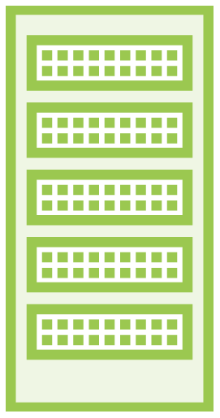



Multiple Services & Multiple Instances
From multiple instances with a single load balancer
To …
Multiple services & multiple instances with multiple load balancers

Slide 8


Different Types of Load Balancing
Server-side
Client-side (caller)

Slide 9
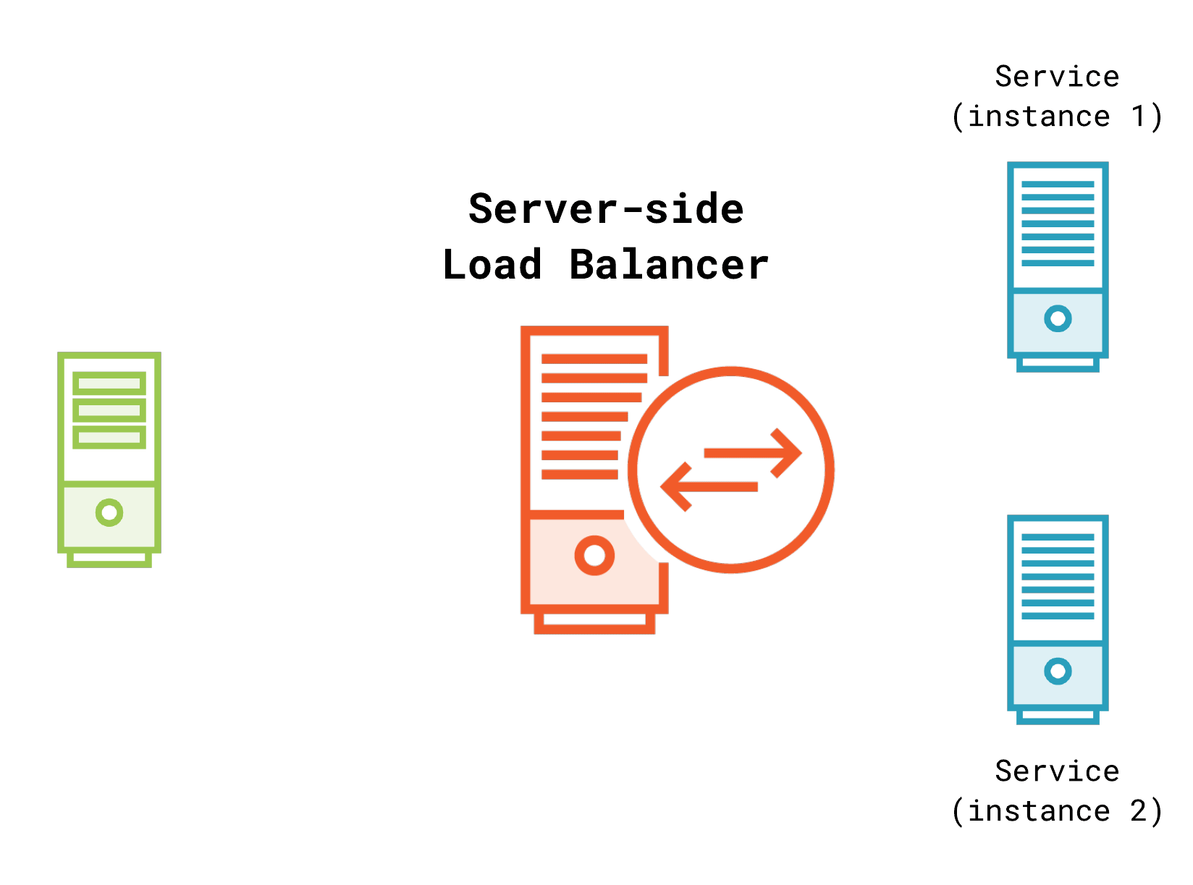
Server-side Load
Balancing

Slide 10
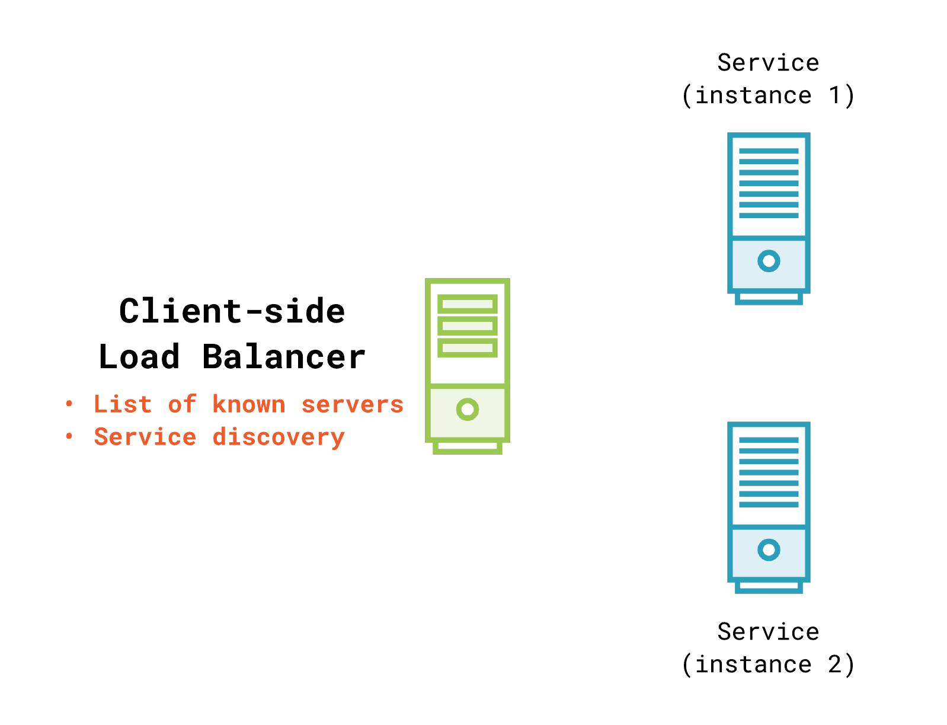
Client-side Load
Balancing

Slide 11
Server-side vs Client-side
Server-side
Server distributes requests Hardware or software based
Extra hop Various balancing algorithms support Occurs outside of the request process
Centralized or distributed
Client-side
Client distributes request Software based
No extra hops
Various balancing algorithms support Occurs within the request process Typically distributed

Slide 12
Client-side load balancing is a natural fit for cloud native architectures.

Slide 13
Client-side Load Balancing
with Spring Cloud

Slide 14
Netflix Ribbon
Ribbon is a Inter Process Communication (remote procedure calls) library with built in software load balancers.
-Netflix Ribbon Project page

Slide 15

Full integration with Spring’s RestTemplate
Customize configuration for different
Balancing algorithms
Availability checks
Spring Cloud
+
Netflix Ribbon

Slide 16
Using Spring Cloud & Netflix Ribbon
pom.xml
<dependencyManagement>
<dependencies>
<dependency>
<groupId>org.springframework.cloud</groupId>
<artifactId>spring-cloud-dependencies</artifactId>
<version>Camden.SR2</version>
<type>pom</type>
<scope>import</scope>
</dependency>
</dependencies>
</dependencyManagement>

Slide 17
Using Spring Cloud & Netflix Ribbon
pom.xml
<dependency>
<groupId>org.springframework.cloud</groupId>
<artifactId>spring-cloud-starter-ribbon</artifactId>
</dependency>

Slide 18


Two New Annotations
@LoadBalanced
Marks a RestTemplate to support load balancing
@RibbonClient
Used for custom configuration and when Service Discovery is absent

Slide 19
Creating a Load Balanced RestTemplate
MyConfiguration.java
@Configuration
public class MyConfiguration {
@Bean @LoadBalanced
public RestTemplate restTemplate() { return new RestTemplate();
}
}

Slide 20
Using a Load Balanced RestTemplate With Service Discovery
Suppose …
my-service is the name of a service running on port 9000 at mycompany.com and is discoverable via Service Discovery. There are 2 instances running.
Instead of …
restTemplate.getForEntity("http://mycompany.com:9000/u/1", ...)
or
restTemplate.getForEntity("http://128.168.10.10:9000/u/1", ...)
Use RestTemplate like this instead …
restTemplate.getForEntity("http://my-service/u/1", ...)

Slide 21

Demo
Using Ribbon with @LoadBalanced and Service Discovery

Slide 22
Two New Annotations
@LoadBalanced
Marks a RestTemplate to support load balancing
@RibbonClient
Used for custom configuration and when Service Discovery is absent

Slide 23
Using a @LoadBalanced RestTemplate
Without Service Discovery
MyConfiguration.java
@Configuration
@RibbonClient(name = "someservice") public class MyConfiguration {
...
}

Slide 24
Using a @LoadBalanced RestTemplate
Without Service Discovery
application.properties
<ribbon_client_name>.ribbon.eureka.enabled=false
<ribbon_client_name>.ribbon.listOfServers=http://host:9000, http://host:9001
OR
application.yml
<ribbon_client_name>: ribbon:
eureka: enabled: false
listOfServers=http://host:9000, http://host:9001
* Replace <ribbon_client_name> with the name field value of @RibbonClient

Slide 25
restTemplate
.getForEntity("http://someservice/", ...)
Using a @LoadBalanced RestTemplate
Without Service Discovery

Slide 26
Demo
Using Ribbon without service discovery

Slide 27
Custom RibbonClient Configuration

Slide 28
Custom Configuration of Ribbon Clients
MyConfiguration.java
package io.schultz.dustin;
@Configuration @RibbonClient(
name = "otherservice",
configuration = OtherServiceConfig.class) public class MyConfiguration {
...
}

Slide 29
◀ Different package so it is not
package io.schultz.config.dustin;
picked up by @ComponentScan
◀ Standard @Configuration class
◀ Define @Beans for customization
@Configuration
public class OtherServiceConfig {
...
}

Slide 30
@Configuration
public class OtherServiceConfig { @Bean
public <bean_type> <method_name>() {
...
}
}
Default Ribbon Client @Beans
Replace <bean_type> and <method_name> with values to override:
http://cloud.spring.io/spring-cloud-static/Camden.SR6/#_customizing_the_ribbon_client
Most likely to be customized: IRule & IPing

Slide 31
The IRule Bean

Slide 32




IRule Implementations
RoundRobinRule
ResponseTime WeightedRule
RandomRule
ZoneAvoidance Rule

Slide 33
IRule: Load Balancing Strategy
@Configuration
public class OtherServiceConfig {
@Bean
public IRule ribbonRule() { return new RoundRobinRule();
}
}

Slide 34
The IPing Bean

Slide 35



IPing Implementations
DummyPing
PingUrl
NIWSDiscovery Ping

Slide 36
IPing: Liveliness Check
@Configuration
public class OtherServiceConfig {
@Bean
public IPing ribbonPing() {
PingUrl pingUrl = new PingUrl();
pingUrl.setExpectedContent("true"); return pingUrl;
}
}

Slide 37
Demo
Customizing a RibbonClient

Slide 38
Differences between client-side & server- side load balancing
Summary
Netflix Ribbon
@LoadBalanced & @RibbonClient
With & without service discovery
Custom Ribbon client configuration

